Slide 1
Variational inference
Using factorized approximations
Part 3: Neural implementation
Weiji Ma, 20140515

Slide 2
Last two weeks
1. Deriving the magic equation
2. Worked example 1: Gaussian
3. Worked example 2: Categorization
4. Relation to population codes

Slide 3
Observations X
World state Z
Generative model p(X,Z)
Posterior p(Z|X)
Motivation: nasty posterior, compute expectations
Approximate using a more pleasant distribution q(Z)
Factorized approximation:
Magic equation:
Functional forms of components q_{i}(Z_{i}) fall out!

Slide 4
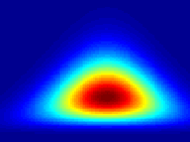
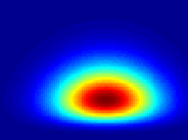
Worked example 1: Gaussian
Set of observations X₁,…,X_{N} , independently drawn from a 1D normal.
Want to compute a posterior over mean μ and precision τ
NormalGamma
Normal x Gamma
True posterior
Variational approximation iteration 10
2
1.5
τ
1
0.5
0
-1
-0.5
0
0.5
1
-1
-0.5
0
0.5
1
μ
μ

Slide 5
Worked example 2: Categorization
C
C=0,1
Category 0
s
Category 1
Probability
σ₀=3º
σ₁=12º
x
-40
-20
0
20
40
Orientation (°)
Qamar et al., 2013

Slide 6
q_{C}(C) is Bernoulli with mean
q_{s}(s) is Gaussian with mean
and second moment

Slide 7
x = 11.2 Variational approximation iteration 10
Joint posterior
Marginal over s
Marginal over C
x 10
-3
7
1
C=0
6
0.8
C=1
5
Posterior
4
0.6
3
0.4
2
1
0.2
-20
-10
0
10
20
0
0
-30
-20
-10
0
10
20
30
0
1
Orientation
Orientation
Category
0.6
1
0.5
10
0.8
0.4
9
0.6
KL(q||p)
mean of q_{s}
mean of q_{C}
0.3
0.4
8
0.2
0.2
0.1
1
2
3
4
5
6
7
8
9
10
7
1
2
3
4
5
6
7
8
9
10
0
1
2
3
4
5
6
7
8
9
10
iteration
iteration
iteration

Slide 8
How to implement variational approximations using PPCs?

Slide 9
Encoding model
s
r
Tuning curves
Poisson variability
Activity
(spikes)
Activity
5
4
3
2
Preferred stimulus
1
0
0
60
120
180
Stimulus

Slide 10
The neural likelihood function
Activity
Probability
Preferred stimulus
Hypothesized stimulus
Function of s, not of r !

Slide 11
Simulation
51 neurons with preferred stimuli s_{i} in [-20, 20]
Gaussian tuning curves with width σ_{tc}=5, baseline b=0.1, and gain g=2
Independent Poisson variability
True stimulus is always s=0
2.5
Gain
2
1.5
Spike count
1
0.5
0
-10
-8
-6
-4
-2
0
2
4
6
8
10
Preferred stimulus

Slide 12
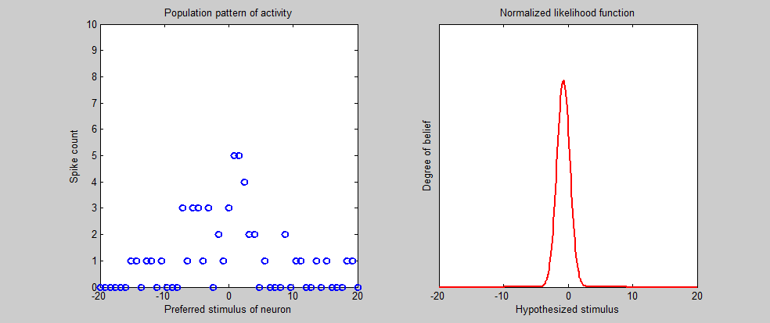
Neural likelihood across trials
Gain = 2

Slide 13
A more general encoding model
Independent Poisson variability
Exercise….
More general: Poisson-like variability
Exponential family with linear sufficient statistics

Slide 14
Poisson-like variability
Not restricted to discrete spike counts
Not restricted to Fano factor of 1
Not restricted to independent neurons
In general, h(s) is determined by the tuning curves and the pairwise correlations of the neurons in the population.

Slide 15
Computational model
Neural model
Stimulus likelihood L(s)
Degree of belief
σ
Find a· r and b· r in terms of µ and σ
x
Hypothesized orientation s

Slide 16
Categorization example: input
C
s
x

Slide 17
Categorization example: output
q_{C}(C) is Bernoulli with mean
q_{s}(s) is Gaussian with mean
and second moment
Rewrite in terms of

Slide 18
From iterative estimation to a dynamical system
q_{C}(C) is Bernoulli with mean
q_{s}(s) is Gaussian with mean
and variance
Iterative estimation
Dynamical system

Slide 19
Dynamical system

